Slide 1
Bouncer Locking System Midterm Presentation
By: John Chrosniak, AJ Given, Derek Martin, and Jamison Stevens
ECE 4440/4991

Slide 2

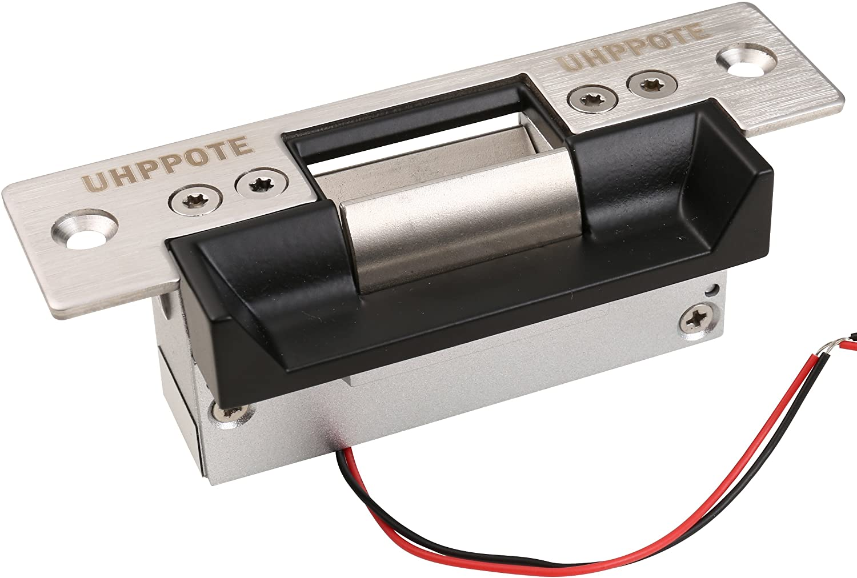
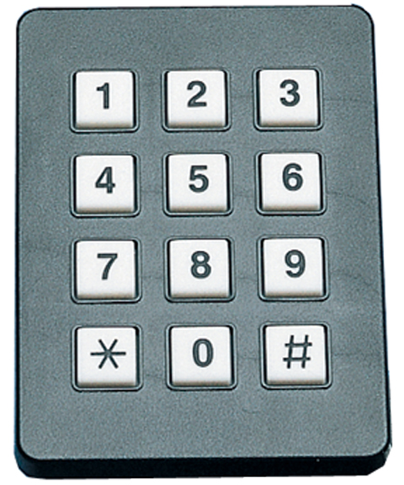
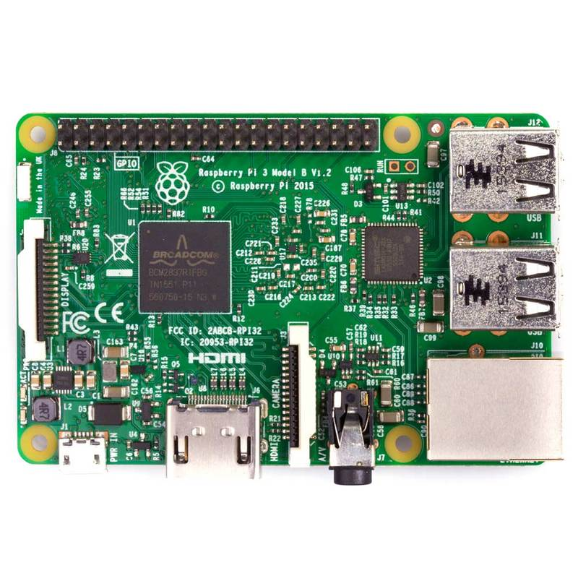


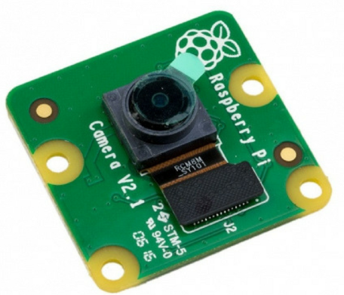
Block Diagrams
Lock Mechanism
Secure Package
Keypad
Camera
Cloud Storage
Raspberry Pi
User Interface

Slide 3
Block Diagrams

Slide 4
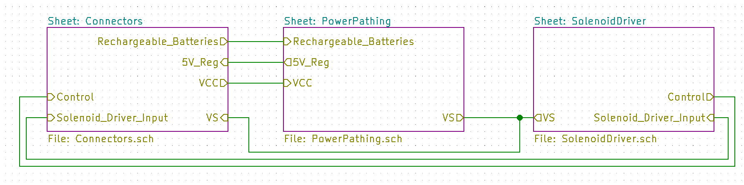
Schematics
Figure 1. Circuit Subsystems

Slide 5
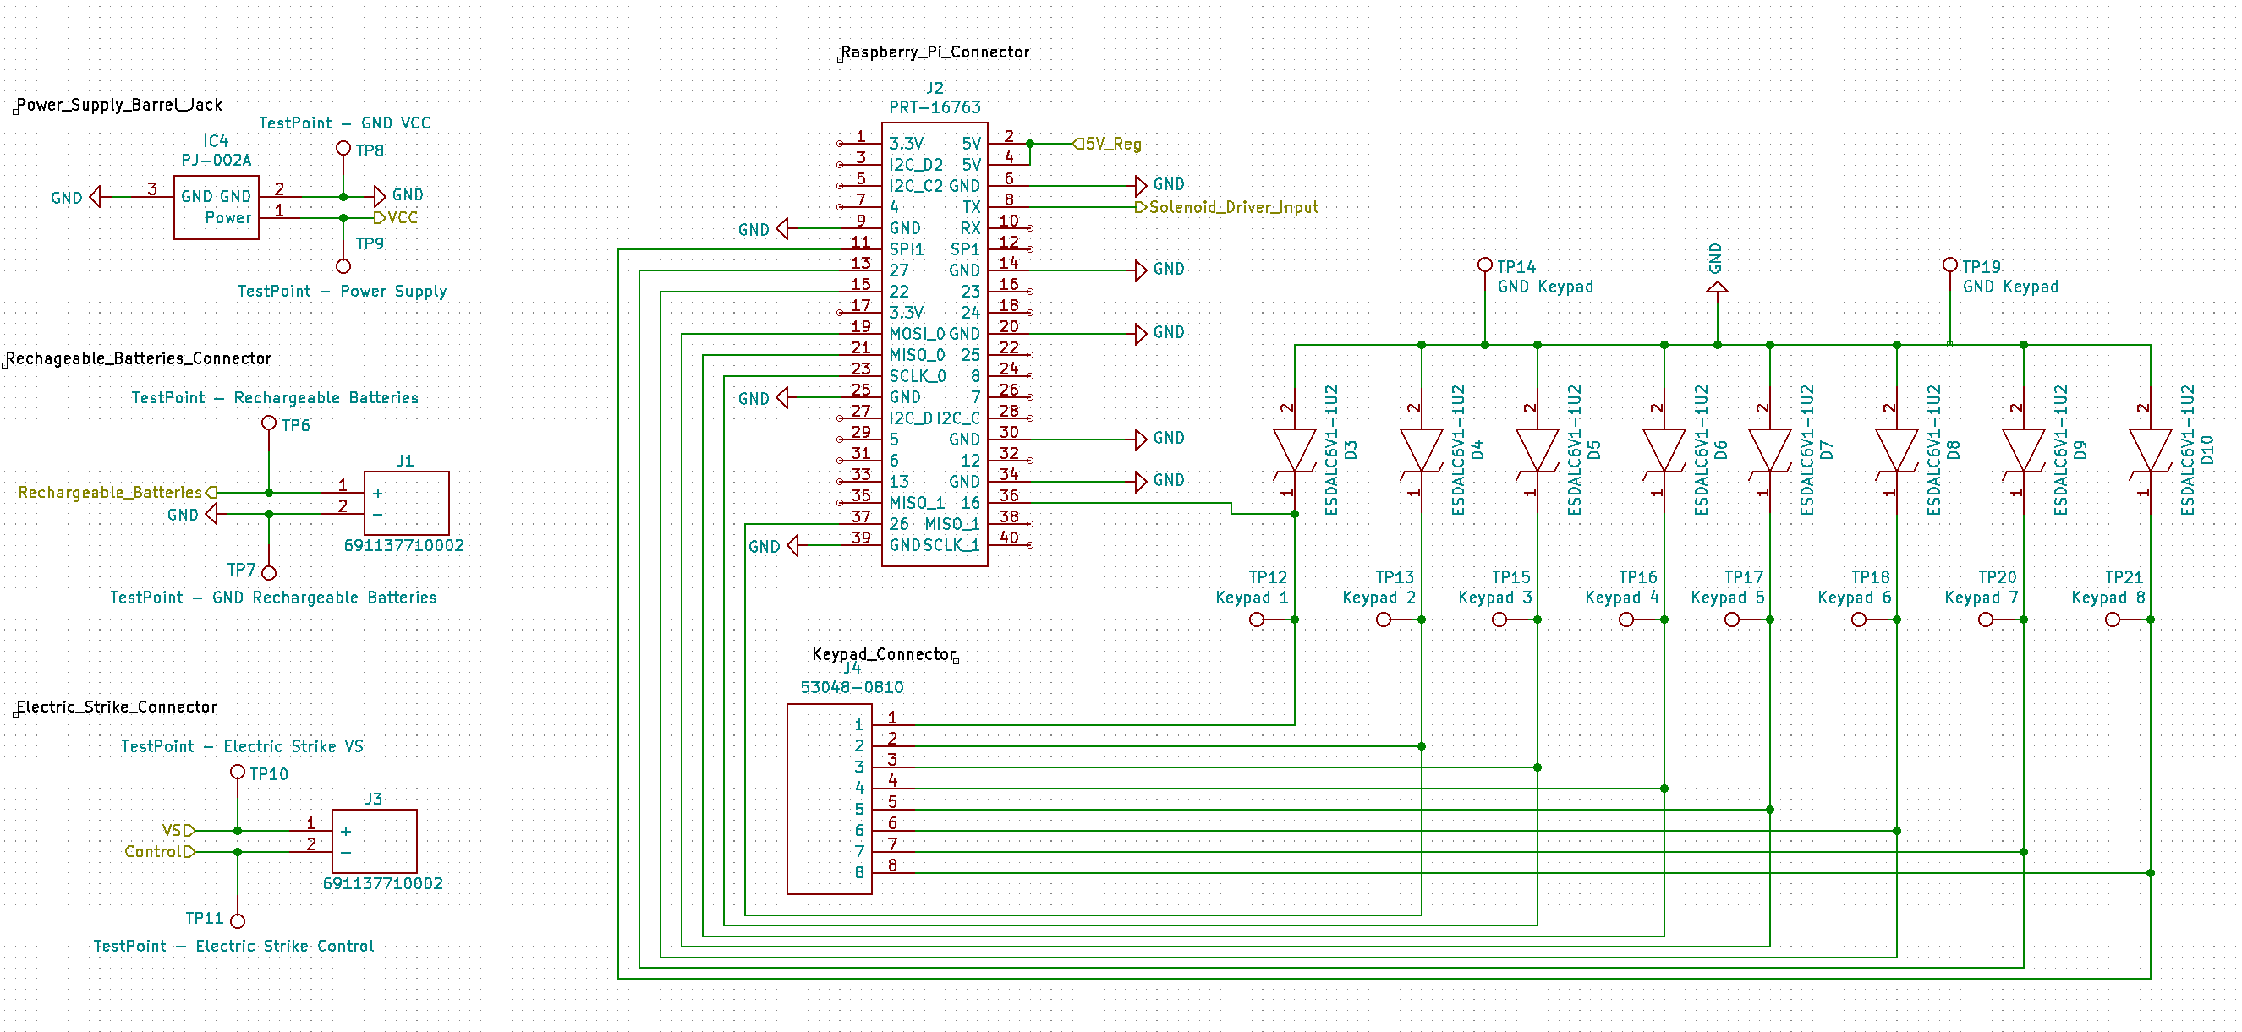
Schematics
Figure 2. Connectors Subsystem

Slide 6
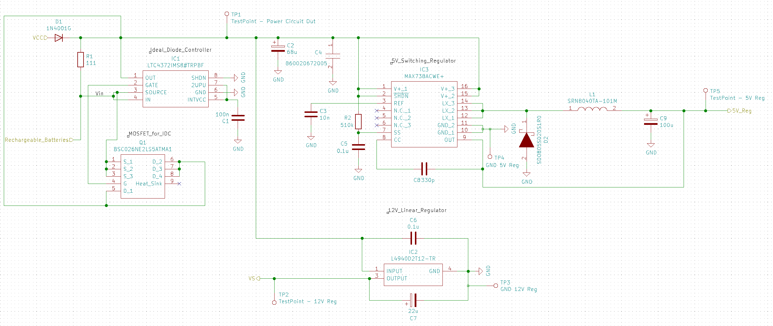
Schematics
Figure 3. Power Supply Subsystem

Slide 7
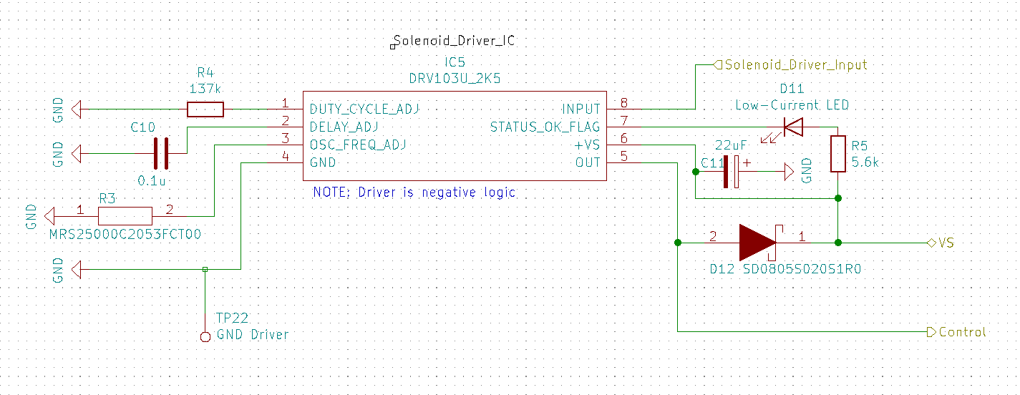
Schematics
Figure 4. Driver Subsystem

Slide 8
Subsystem Demo
Explain in detail what subsystem you are going to demo first
Ideas:
Demo camera recording and pushing videos to cloud
Demo web application pulling videos from cloud

Slide 9
Testing So Far
Results of any preliminary testing performed
Has testing caused modifications to design approach?
Ideas:
Testing current draw of lock impacted component choices
Maybe talk about switch from MSP to pi

Slide 10
Team Member Responsibilities
Explain each team member’s primary responsibility
How are we parallelizing tasks
NOTE: WHOEVER IS RESPONSIBLE FOR EACH TASK SHOULD BE PRESENTER FOR THAT PORTION

Slide 11
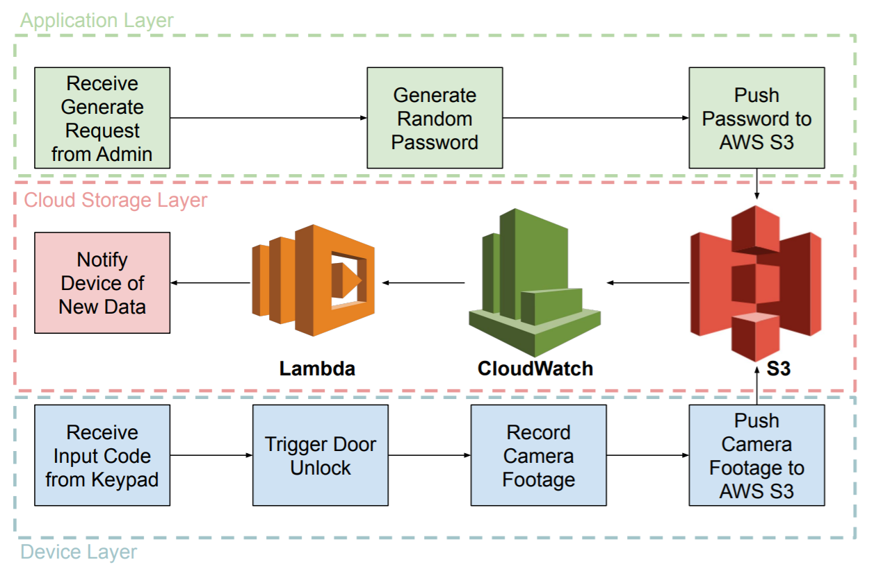
Software/Microcontroller
Would chosen platform be desirable if project went into mass production?
It is fine if the prototyping CPU is much more expensive than one that might be selected for production

Slide 12
Test Plan
Explain how you plan to test your project
Consider points for Design for Test (WHAT DOES THIS MEAN???)
Make reviewers aware how testability is part of your design
Clear, logical testing plan on a decision tree
Give an analysis of the likely failure modes
Test Power Supply
Test Barrel Jack and Rechargeable Batteries Connectors
Test 5 V and 12 V Regulator
Test Ideal Diode Controller
Test Connectors
Test Raspberry Pi Connector Pins
Test Electric Strike Connector
Test Keypad Connector
Test Solenoid Driver

Slide 13
Current Status
Hardware
Finished preliminary design of hardware schematics
In the process of finishing circuit board layout
Firmware
Successfully integrated camera with Raspberry Pi
In the process of uploading video footage to AWS
Software
Completed design of web application interface
Created algorithm to securely generate random passwords
In the process of pushing passwords to Raspberry Pi

Slide 14
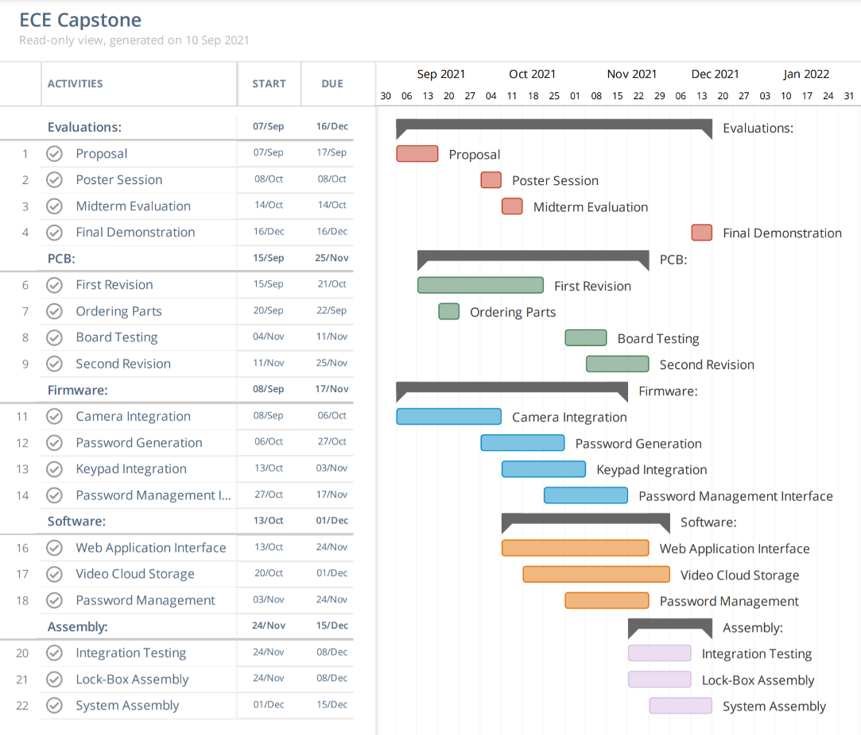
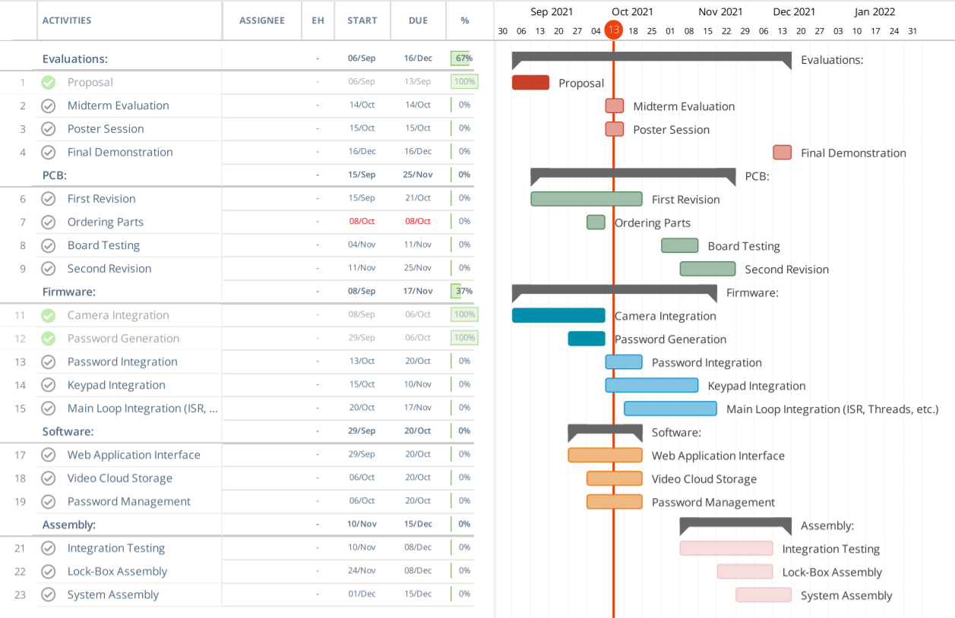
GANTT Charts
Original Gantt Chart
Current Gantt Chart

Slide 15
Questions
Allow 2 minutes extra for questions

